Slide 1
Decision Trees
Jerome
Fleischman
Isaac
Attuah
Daniel
Portuondo

Slide 2
Decision Trees
Primary strength is the reduction and elimination of irrelevant and redundant attributes, increased interpretability, and lower risk of overfitting noisy data
At each node of the tree, the amount of information each attribute provides is calculated
The attribute with the highest information gain is used as the node, then recursively apply the information gain formula to the remaining attributes

Slide 3
Information Gain
Calculate entropy of class labels:
H(T) = -p_{pos}log₂ p_{pos} - p_{neg}log₂ p_{neg}
1
2
Calculate the entropy of all values v in attribute at
H(v₁) = -p_{(v1 | pos)}log₂ p_{(v1 | pos)} - p_{(v1 | neg)}log₂ p_{(v1 | neg)}
H(v₂) = -p_{(v2 | pos)}log₂ p_{(v2 | pos)} - p_{(v2 | neg)}log₂ p_{(v2 | neg)}
3
Calculate the average entropy of attribute at
H(T, at) = p_{(v1 | T)}* H(v₁) + p_{(v2 | T)}* H(v₂)
4
Calculate information gain
H(T) - H(T, at) = I(T, at)

Slide 4
Inducing Different Trees
Utilizing different subsets of training examples results in varying trees of varying sizes
Typically, the smaller the tree the better
Pruning trees can, to an extent, improve interpretability and effectiveness
Too much pruning can have the opposite effect
Attributes that do not appear in the tree can be considered redundant or irrelevant as they do not need to be considered for classification

Slide 5
Predicting Political Party
Physician
Fee Freeze
Democrat
Synfuels
Cutback
MX
Missile
Republican
Democrat
Budget
Resolution
Democrat
Republican

Slide 6
Project Goal
Choose 3 UCI repositories that can support the Decision Tree classification method
On each repository, induce a decision tree model for varying subsets of the training data and test each on one consistent testing set
Leverage the power of WEKA software to construct these models and analyze the results

Slide 7

WEKA Showcase
WEKA is an open-source machine learning software developed in New Zealand
The WEKA Java API, in conjunction with Python, was utilized to conduct varying experiment and collect relevant data

Slide 8
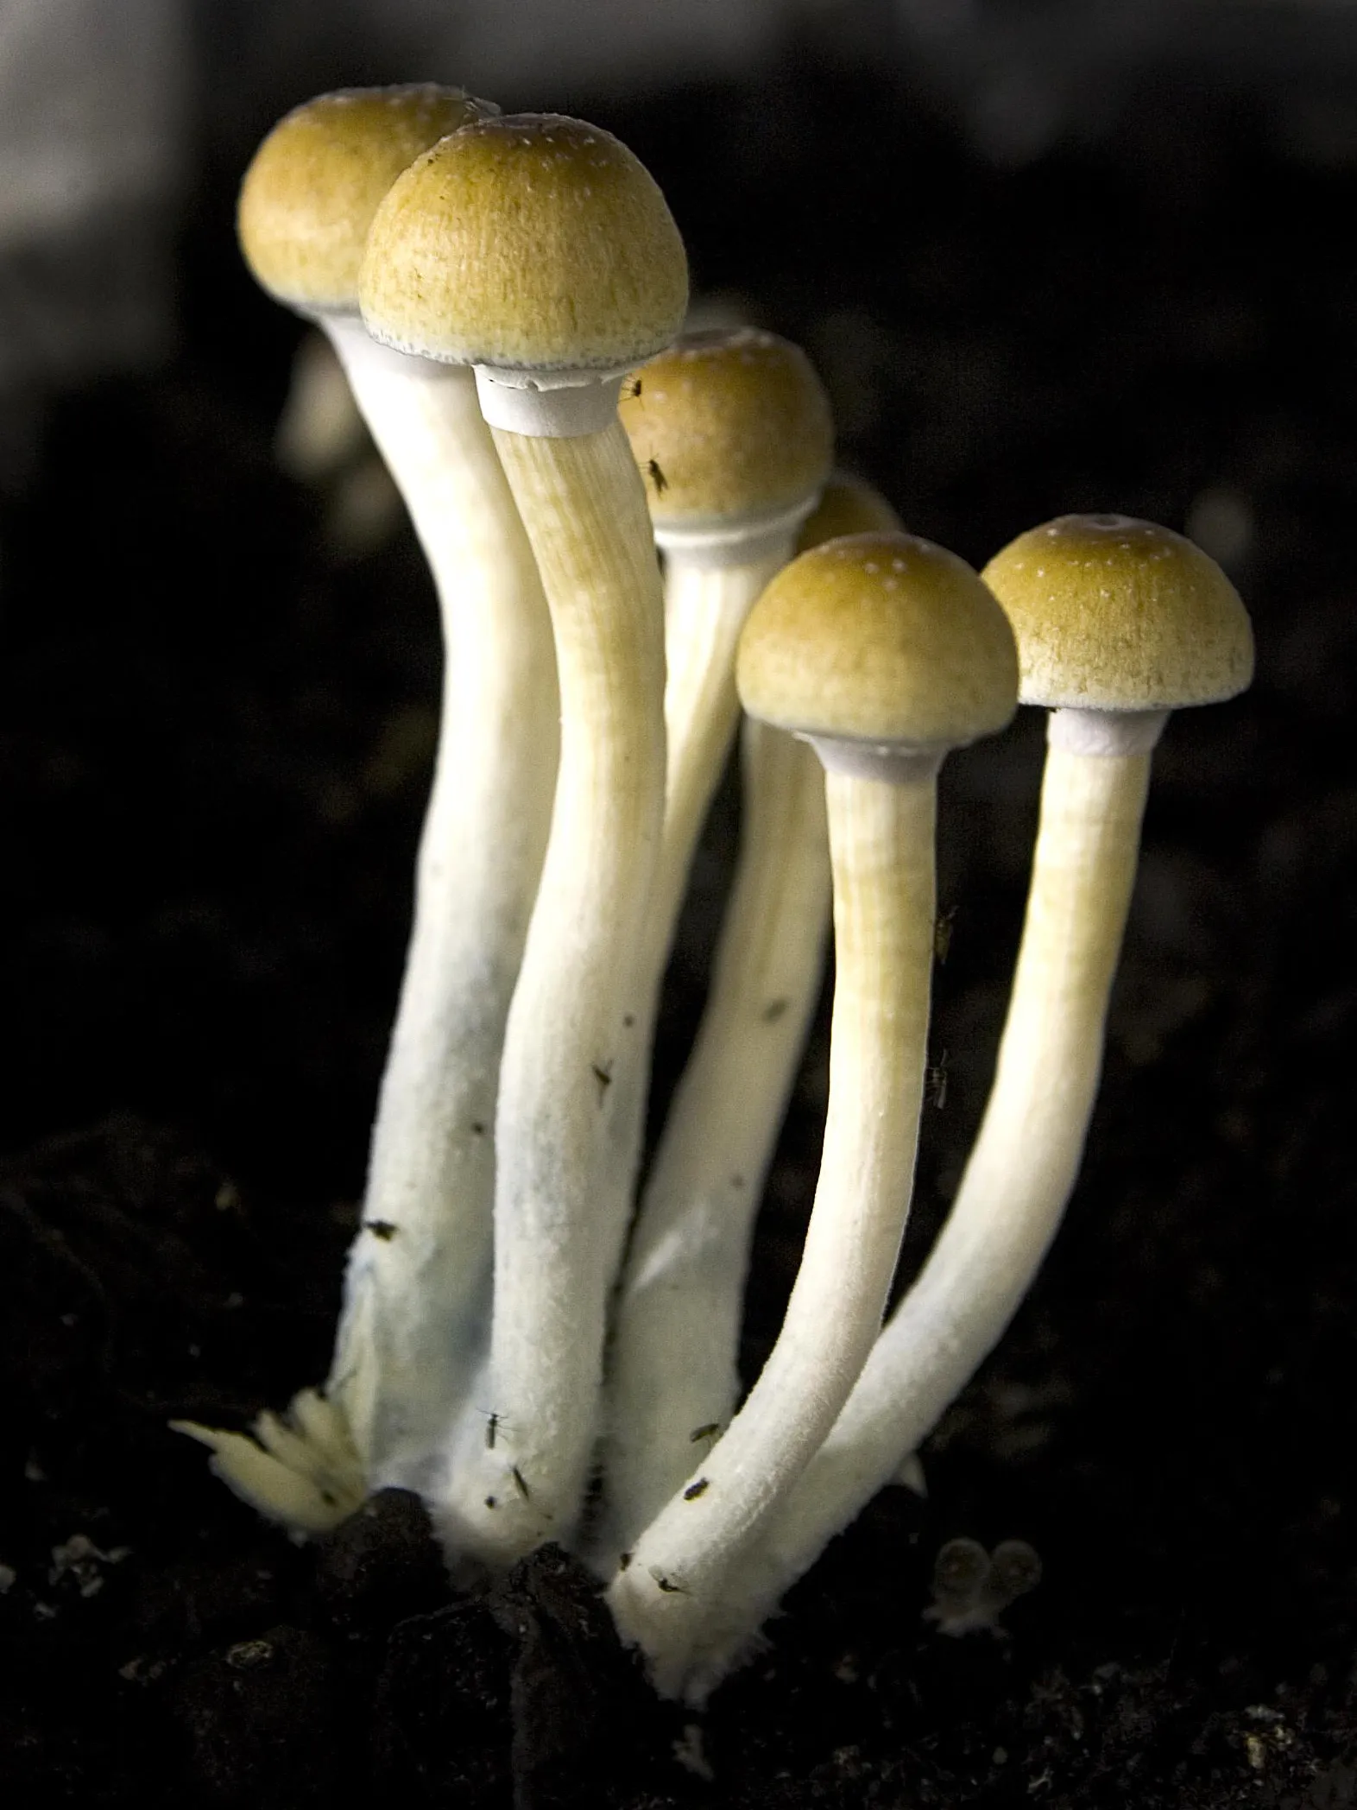
Determining
Mushroom
Toxicity

Slide 9
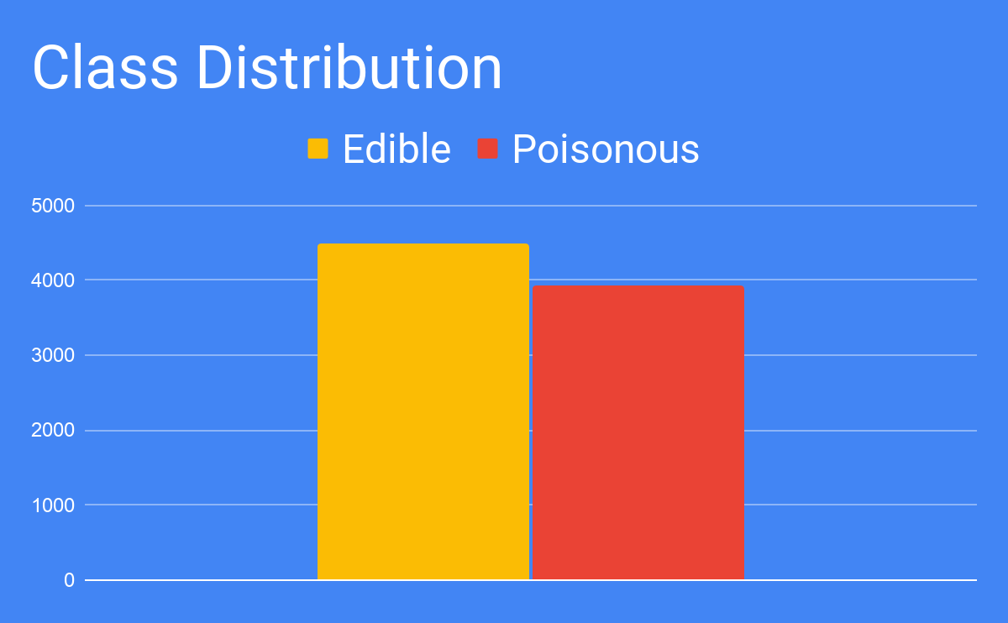
Data Set Info
Total Examples
8416
Attribute Count
23
Class Type
Discrete

Slide 10
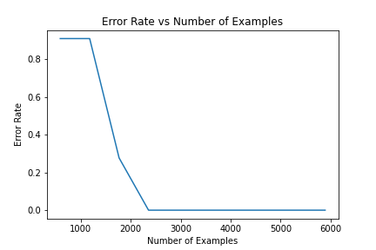
Error Rate Results
Perfect accuracy is achieved with
minimal examples
Only 30% of the set, roughly 2,400 examples, is required
Why?

Slide 11
Simplified Tree
Pungent
Almond
Anise
Foul
None
Edible
Poisonous
White
Brown
Black
Close
Crowded
Edible
ROOT: Odor
Depth 2: Spore Print Color
Depth 3: Gill Spacing

Slide 12
Most Valuable Attributes
Decision trees are powerful tools for identifying the most relevant attributes and eliminating irrelevant ones
Using only the root of the tree, 55% of examples can be classified
The second level classifies another 37%
The decision tree ultimately requires only 5 of the 23 attributes to correctly classify 100% of the testing set

Slide 13
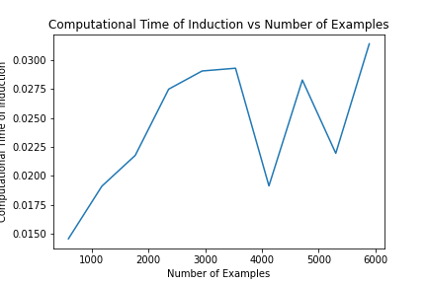
Induction Time
Induction occurs in under 30 milliseconds
All attributes are discrete, requiring less computation
Apparent volatility is only due to the miniscule increments of the y-axis
Anything beyond 2500 examples is unnecessary

Slide 14

Identifying
Dry Beans

Slide 15
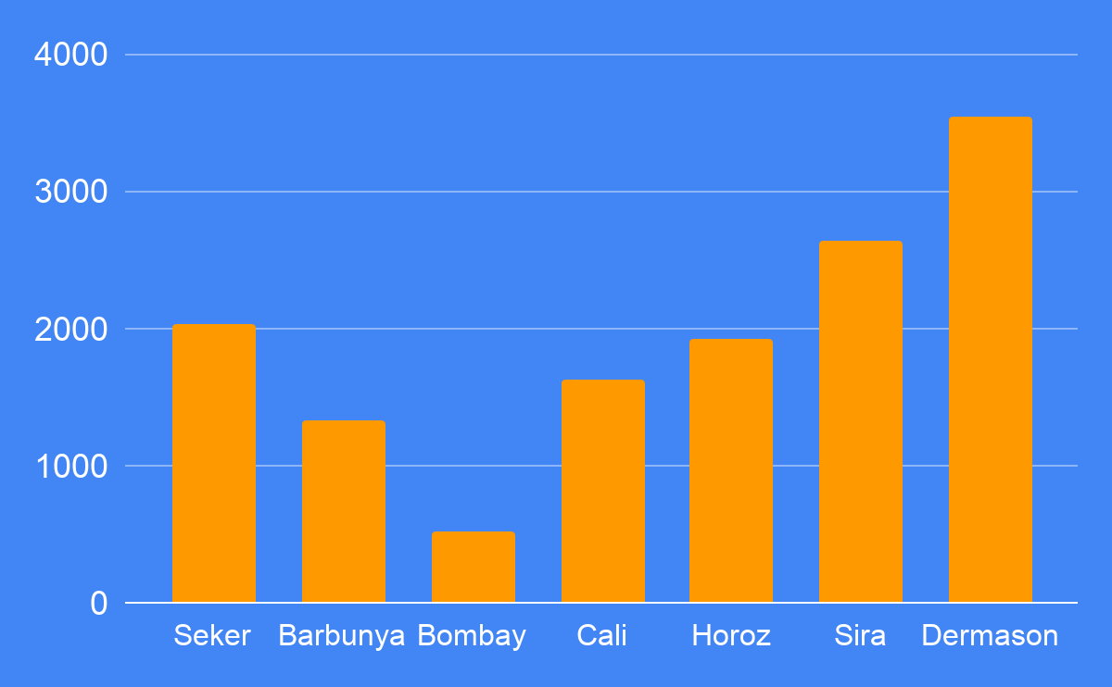
Data Set Info
Total Examples
13611
Attribute Count
17
Class Type
Continuous

Slide 16
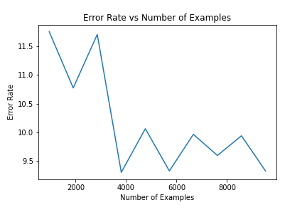
Error Rate Results
Error rate remains relatively consistent, albeit improving slightly
2% improvement upon reaching upon reaching 30% training size
Did not improve beyond this point

Slide 17
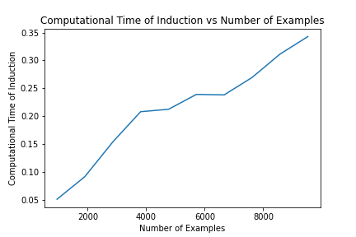
Induction Time
Despite using roughly the same size of examples as the Mushrooms domain, induction time is significantly higher
After 4000 examples, further computations are unnecessarily expensive

Slide 18
Higher Costs, Less Accuracy
All attributes in this data set are continuous, requiring the additional computational cost of finding the binary split threshold for each one
Depth of the tree is 19, meaning there are more layers than attributes
Neither depth nor accuracy improved despite additional training data
This could suggest that most, if not all, attributes are relevant, resulting in repeating cases of attributes and less accurate results
A tree of this size is in danger of overfitting data

Slide 19
Determining Connect 4
Outcomes

Slide 20
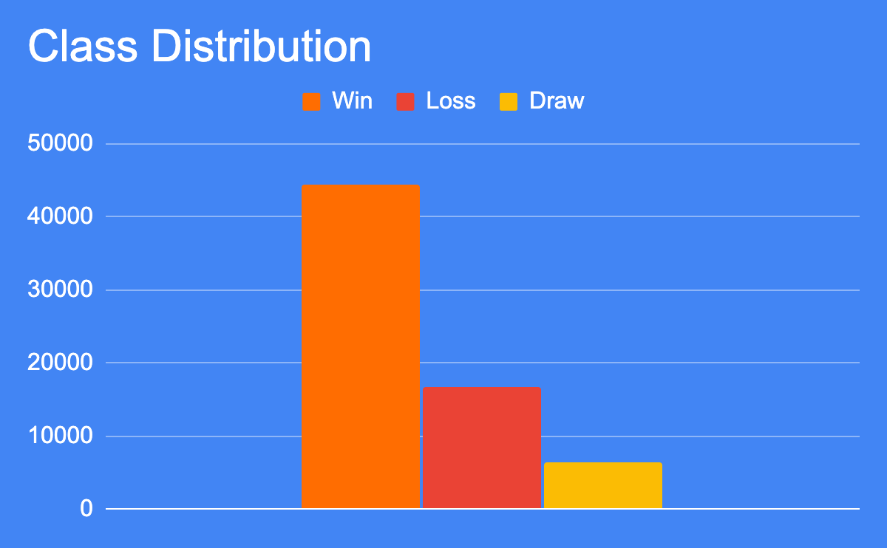
Data Set Info
Total Examples
67,557
Attribute Count
43
Class Type
Discrete

Slide 21
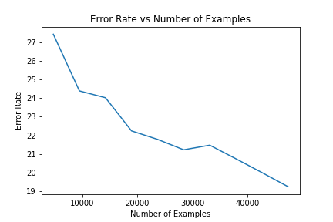
Error Rate Results
Error rate continues to decrease substantially as training sample size increases
This suggests more examples could lead to improved accuracy
This could be due to the large dissonance between classes, as the confusion matrix suggests

Slide 22
Confusion Matrix
Predicted
Win
Draw
Loss
Win
676
12,311
302
Actual
Draw
982
431
513
Loss
1,175
288
3,589
More Draws were misclassified as Wins than actual Draws
Losses and Draws suffered more misclassifications than Wins
Maximum depth of tree is only 17, suggesting relatively low relevant attributes

Slide 23
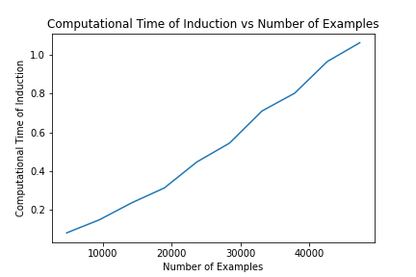
Induction Time
Computational demand increases almost linearly
This is likely due to sheer amount of examples
As accuracy also increases, there is a trade-off between performance and time taken

Slide 24
Decision Tree Pruning
With Pruning
Without Pruning
# of Leaves
4,297
10,635
Size of Tree
6,445
15,952
Accuracy
80.6%
79.4%

Slide 25
Conclusions
Additional examples are not always necessary if few relevant attributes carry enough weight
Balanced datasets result in improved accuracy and faster tree induction
Discrete attributes tend to perform better than continuous attributes

Slide 26
Conclusions
Increased complexity (poor class distribution, large amount of relevant attributes, etc.) demands larger, more intricate trees with higher computational costs and lower accuracy
The depth of the decision tree is therefore related to how many attributes influence a classification
Decision trees are best used when the number of relevant attributes is low or to determine if this is the case

